Slide 1
Synchronization Mechanisms
Concept of processes and threads –the critical section problem – other synchronization problems

Slide 2
Process
A process is just an instance of an executing program, including the current values of the program counter, registers, and variables
It Support the ability to have (pseudo) concurrent operation even when there is only one CPU available.
In all modern Multiprogramming systems, the CPU switches from process to process quickly running each for tens or hundreds of milliseconds
A program is a passive entity, such as a file containing a list of instructions stored on disk
A program becomes a process when an executable file is loaded into memory.

Slide 3
Process model
All the runnable software on the computer, sometimes including the operating system, is organized into a number of sequential processes.
The CPU switches back and forth from process to process, serving each one of them.
Scheduling algorithms are used to give fixed time intervals of CPU execution for each process, there by implementing multiprogramming.

Slide 4
Process Hierarchies
A process may create several new processes during its time of execution.
The creating process is called "Parent Process", while new processes are called "Child Process
The child process can also create other processes if required.
This parent-child like structure of processes form a hierarchy, called Process Hierarchy.

Slide 5
Process States
When process executes, it changes state, based on the current activity of the process.
The process may be in one of the following states:
New: The process is being created.
Running. Instructions are being executed.
Ping. The process is Ping for some event to occur (such as an I/O completion or reception of a V).
Ready. The process is Ping to be assigned to a processor.
. Terminated The process has finished execution
Notes:
Four principal events cause processes to be created:
1. System initialization.
2. Execution of a process-creation system call by a running process.
3. A user request to create a new process.
4. Initiation of a batch job.

Slide 6
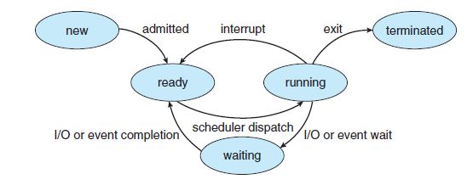
Process State
Only one process can be running on any processor at any instant
Many processes may be ready and Ping
Notes:
Process will terminate, usually due to one of the following conditions:
1. Normal exit (voluntary).
2. Error exit (voluntary).
3. Fatal error (involuntary).
4. Killed by another process (involuntary).

Slide 7
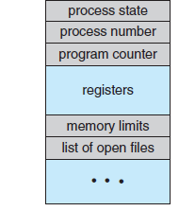
Implementation of Process
Each process is represented in the operating system by a process control block, containing information associated with a specific process.

Slide 8
Process Control Block
Process state: The state may be new, ready, running, Ping, halted, and so on.
Program counter: The counter indicates the address of the next instruction to be executed.
CPU registers: Include accumulators, index registers, stack pointers, and general-purpose registers.
CPU-scheduling information: This information includes a process priority, pointers to scheduling queues, and any other scheduling parameters.
Memory-management information: Memory allocation details of the process

Slide 9
Concurrent Processes
Two processes are concurrent if their execution overlap in time.
In multiprocessor systems ,with CPUs executing different processes, Concurrency is easy to visualize.
In single CPU system logical concurrency happens if a CPU interleaves the execution of various Processes.
Concurrent processes uses two mechanisms to interact with each other
Shared variable: The processes access(read or write) a common variable or common data
Message Passing: The processes exchange information by sending and receiving message

Slide 10
Threads
A thread is a basic unit of CPU utilization which comprises a thread ID, a program counter, a register set, and a stack
Thread is a single sequence stream within a process.
Threads have same properties as of the process so they are called as light weight processes.
A traditional (or heavyweight) process has a single thread of control

Slide 11
Threads
Most software applications that run on modern computers are multithreaded.
The process for the application will have multiple threads, each thread performing a particular task.
The CPU switches rapidly back and forth among the threads, providing the illusion that the threads are running in parallel.
For example a web server handling request from multiple clients , a thread can be created for serving each client

Slide 12
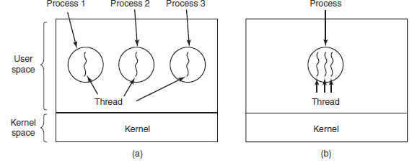
Single threaded & multithreaded

Slide 13
Threads
Each thread belongs to exactly one process and no thread can exist outside a process.
Threads within a process share data, code and resources
Each thread represents a separate flow of control.
Threads have been successfully used in implementing network servers and web server.
They also provide a suitable foundation for parallel execution of applications on shared memory multiprocessors

Slide 14
Threads-States
Like a traditional process (i.e., a process with only one thread), a thread can be in any one of several states: running, blocked, ready, or terminated.
A running thread currently has the CPU and is active. In contrast, a blocked thread is Ping for some event to unblock it.
Ready thread is scheduled to run and will as soon as its turn comes up

Slide 15
Benefits of Threads
The benefits of multithreaded programming can be broken down into four major categories:
Responsiveness: allow a program to continue running even if part of it is blocked or is performing a lengthy operation.
Resource sharing: threads share the memory and the resources of the process to which they belong by default.
Economy : As threads in same process share the resources ,we can save the cost of individual process creation.
Scalability: In a multiprocessor architecture, threads may be running in parallel on different processors

Slide 16
Types of Threads
There are two types of threads to be managed in a modern system:
User level threads
Kernel level threads
User threads are created in user space, without kernel support.
The kernel knows nothing about the user threads
These are the threads that application programmers would put into their programs.
Each process needs its own private thread table to keep track of the threads in that process.

Slide 17
Types of Threads
Operating-system kernel supports and manages kernel-level threads.
Kernel has a thread table that keeps track of all the threads in the system.
When a thread wants to create a new thread or destroy an existing thread, it makes a kernel call, which performs the operation and updates table.
The kernel threads are costlier and slower when compared to user threads.
Most modern operating systems provide kernel support for threads.
Thread libraries provide the application programmer with an API for creating and managing threads.

Slide 18
Critical section problem & other synchronization problems

Slide 19
Critical Section Problem
As the computers are multitasking, often there are processes executing concurrently.
This can contribute to issues involving the integrity of data shared by several processes.
Examples of integrity violation are:
Variables doesn’t record all changes
Process may read inconsistent values
Final value of variable may be inconsistent

Slide 20
The Critical-Section Problem
Solution : the process should be synchronized so that only one process can access the variable at any one time
This is also referred to as Problem of Mutual Exclusion
The critical section is a code segment in a process in which shared resource is accessed.

Slide 21
The Critical-Section Problem
We need four conditions to hold to have a good solution:
1. No two processes may be simultaneously inside their critical Sections.
2. When no process is executing in its critical section , any process that request entry to critical section must be permitted to enter without delay
3. When 2 or more process compete to enter its critical region the selection cannot be postponed indefinitely.
4. No process can prevent any other process from entering its critical section indefinitely.

Slide 22
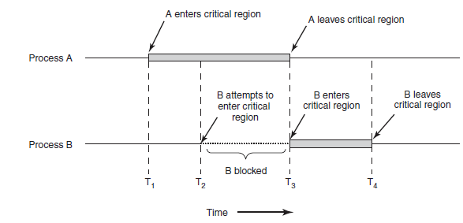
The Critical-Section Problem

Slide 23
Early Solutions to CS/Mutual Exclusion Problem
Busy Ping : first mechanism introduced to achieve mutual exclusion
A process which cannot to access critical section continuously checks a status variable to find out the availability of shared resource.
Main draw back: CPU cycle wastage

Slide 24
Early Solutions to CS/Mutual Exclusion Problem
Disabling Interrupts: another mechanism that achieves mutual exclusion
A process disable interrupts just before it enters its critical section and enables the interrupt immediately after exiting the critical section
Mutual exclusion is achieved, as the process is not interrupted during CS execution and excludes all other processes from entering
Drawback: Applicable only to uniprocessor system

Slide 25
Semaphores
Semaphore is a high level construct used to synchronize concurrent processes.
A semaphore is an integer variable on which processes can perform 2 operations P(s) and V(s)
Each semaphore has a queue associated with it ,containing processes that are blocked on semaphore.
The operations P(s) and V(s) restricts the entry into the critical section ensuring mutual exclusion to shared resource

Slide 26
Semaphores
Operations P(also known as P) and V(V) are defined as follows:
P(S): if S≥1 then S=S-1
else block the process on semaphore queue
V(S):if some processes are blocked on semaphore unblock it
else S=S+1

Slide 27
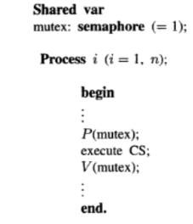
Types of Semaphores
There are two types of semaphore depending upon the value of semaphore:
Binary semaphore: Initial value of S is 1
Resource counting semaphore: initial value >1

Slide 28
Semaphores: Drawbacks
A process using semaphore has to know which other processes are using semaphore to co-ordinate the semaphore operations to interacting processes
Semaphores must be carefully installed. An omission of P or V operation may result in inconsistencies.
Programmes using semaphore are extremely hard to verify

Slide 29
Other Synchronization Problems
In addition to mutual exclusion there are other situations where process synchronization is necessary.
Some common synchronization problems are:
The Dining Philosophers problem
The Producer consumer problem
The Readers-Writers problem

Slide 30
The Dining Philosophers problem
Classic synchronization problem used to evaluate situations where there is a need of allocating multiple resources to multiple processes.
There are 5 philosophers sitting around a round table eating spaghetti
But there are only 5 chopsticks/forks one to the left and one to the right of each philosopher
Each philosopher needs both forks to eat the spaghetti.
If each philosopher is getting hold of one fork, none of them will be able to eat the spaghetti
Dining philosophers problem is an excellent example to explain the concept of deadlock while resource sharing in OS.

Slide 31
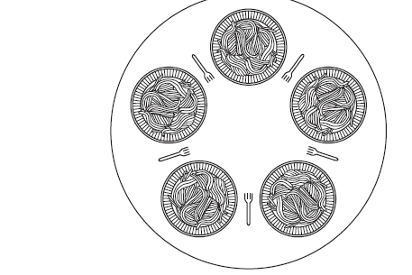
Dining Philosophers Problem

Slide 32
The Dining Philosophers problem
Philosopher alternates between 2 phases:
Thinking:-Philosopher doesn’t hold any fork
Eating:-Philosopher holds 2 forks and eats.
After being in thinking state for some time, the philosopher picks up forks on both sides and starts eating.
Philosopher can eat only if he has 2 forks.
Once philosopher starts eating, he doesn’t leave the fork until the eating phase is over
Notes:
Consider the philosophers to be processes and the chopsticks to be a shared resource. Every process needs two resources out of which one it has already acquired and the other is acquired by some other process. Till the other process does not free the resource, this process cannot proceed. Similarly, the other process is dependent on another process for its resource. Since every process is dependent on each other, it forms a circular-P and the system goes into a deadlock condition.

Slide 33
The Dining Philosophers problem
When eating phase is over, philosopher puts back the forks and enters thinking phase.
Here no two neighbours can eat simultaneously.
The act of picking a fork by philosopher must be critical section .
Need to devise a solution so that no philosopher starves.(need to prevent deadlock)

Slide 34
Producer Consumer Problem
This is another important Multi process synchronization problem.
It is a common paradigm for concurrent processes.
A producer process produces information which is consumed by consumer process.
Eg: In client server architecture, server can be considered as producer and client as consumer.
To implement the same, producer and consumer share a buffer in which producer adds information which will be emptied by the consumer.
Notes:
For example, a web server produces (that is, provides) HTML files and images, which are consumed (that is, read) by the client web browser requesting the resource.

Slide 35
What is the Problem?
A fixed size buffer is used which should satisfy the following constraints
No consumer process should remove data from buffer when it is empty
No producer process can deposit data , when buffer is full.
Integrity problem arises if the multiple consumers(or producers) try to remove data(or add data) in buffer simultaneously.
So one process at a time should be able to access the buffer(mutual exclusion).
These problems can be solved by using semaphores

Slide 36
The Readers-Writers Problem
Here shared resource is a file that is accessed by both the reader and writer processes.
Reader process simply read the information in file without changing its contents.
Writer process may change the information in the file
Constraints are:
Any no: of readers can access the file concurrently, (R-R)-possible
When a reader process reads the file no writer can access the file.(R-W) not allowed
When writer process is accessing the file no other read or write Process can access the file. (W-R) and (W-W) not possible

Slide 37
Versions of Readers Writers Problem
Several versions of the problem exists depending upon whether readers or writers are given priority
Readers Priority
Arriving readers receive priority over Ping writers.
A Ping/arriving writer gains access if there are no readers in the system.
Writers Priority
Arriving writer receives priority over Ping reader
A Ping/arriving reader gains access if there are no writers in the system.

Slide 38
Solution to R-W problem using Semaphore
Readers share 2 semaphores read and write both with initial value 1.
Integer variable count initialized to 0,shared by reader processes.
Writer process shares semaphore write.
Count is used to count no: of readers reading the file
Read semaphore provides mutual exclusion to readers when count is updated.
Write semaphore provides mutual exclusion to writers. Accessed by all writers and the first and last reader that enters or exits critical section

Slide 39
Solution using Semaphore
/* Reader Process*/
P(read);
Count++;
If(count==1)
P(write);/* first reader process blocks other writer processes*/
V(read);
………………………………..
Reading contents of file
……………………………………
/*other readers also reads the file */
P(read);
Count--;
If(count==0) /*last reader*/
V(write);/*unblocking writer process*/
V(read);/*unblock the read semaphore*/
/*writer Process*/
P(write);
………………………
Updating the file
……………………….
V(write);

